Slide 1
CSSE3113 – Introduction to Software Engineering
Requirements Modelling

Slide 2
Requirement Modelling
The intent of the analysis/requirement model is to provide a description of the required informational, functional, and behavioral domains for a computer-based system.
The model changes dynamically as you learn more about the system to build.
Other stakeholders understand more about what they really require.
There are different modes of representation that force you to consider requirements from different viewpoints---an approach that has a higher probability of uncovering omissions, inconsistencies, and ambiguity.

Slide 3
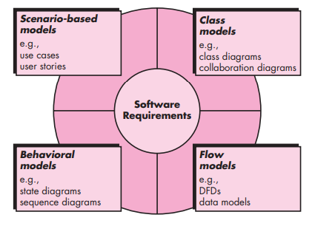
Requirement Modelling

Slide 4
Scenario-based Modelling
The scenarios often called use cases, proved a description of how the system will be used.
In essence, a use case tells a stylized story about how an end user interacts with the system under a specific set of circumstances.
The story can be a narrative text, an outline of tasks or interactions, a template-based description, or a diagrammatic representation.

Slide 5
Scenario-based Modelling- Use case
A collection of user scenarios that describe the thread of usage of a system
Each scenario is described from the point-of-view of an “actor”—a person or device that interacts with the software in some way ( not necessarily users) to External entities.
For example, a machine in four different modes of programming, test, monitoring and troubleshooting modes. Four actors can be defined. Programmer, tester, monitor, and troubleshooter.
In some cases, the machine operator can play all of these roles. Or different people can play different roles.

Slide 6
Scenario-based Modelling- Use case
Once actors are defined, use cases can be developed. Each scenario answers the following questions:
Who is the primary actor, the secondary actor (s) ( to support the primary actors)?
What are the actor’s goals?
What preconditions should exist before the story begins?
What main tasks or functions are performed by the actor?
What extensions might be considered as the story is described?
What variations in the actor’s interaction are possible?
What system information will the actor acquire, produce, or change?
Will the actor have to inform the system about changes in the external environment?
What information does the actor desire from the system?
Does the actor wish to be informed about unexpected changes?

Slide 7
system name
system boundary
ATM System
primary actor
1
Withdraw
Money
secondary actor
2
Deposit
Money
Bank Customer
Customer Accounts Database
3
Transfer
Money
role
association
4
Check
Balance
<<Customer
Accounts
Database>>
use case
alternative actor notation
stereotype

Slide 8
Class-based Modelling
It shows the classes of the system, their inter-relationships, and the operations and attributes of the classes
Explore domain concepts in the form of a domain model
Analyze requirements in the form of a conceptual/analysis model

Slide 9
Class-based Modelling
Class-based modeling represents:
Objects that the system will manipulate
Operations (also called methods or services) that will be applied to the objects to effect the manipulation
Relationships (some hierarchical) between the objects
Collaborations that occur between the classes that are defined.
The elements of a class-based model include classes and objects, attributes, operations, and collaboration diagrams.

Slide 10
Identifying Classes
Examining the usage scenarios developed as part of the requirements model and perform a "grammatical parse“.
Classes are determined by underlining each noun or noun phrase and entering it into a simple table.
Synonyms should be noted.
If the class (noun) is required to implement a solution, then it is part of the solution space; otherwise, if a class is necessary only to describe a solution, it is part of the problem space.
But what should we look for once all of the nouns have been isolated?

Slide 11
Class
A class is a description of a set of
objects that share the same attributes,
operations, relationships, and semantics.
Graphically, a class is rendered as a
rectangle, usually including its name,
attributes, and operations in separate,
designated compartments.
ClassName
attributes
operations
Notes:
Semantic-> meaning and interpretation of words

Slide 12
Class Name
ClassName
The name of the class is the only required tag in the graphical representation of a class. It always appears in the top-most compartment.
attributes
operations

Slide 13
Class Attributes
Person
An attribute is a named property of a
class that describes the object being modeled.
In the class diagram, attributes appear in the second compartment just below the name-compartment.
name : String
address : Address
birthdate : Date
CNIC : Id

Slide 14
Class Operations
Person
name : String
address : Address
birthdate : Date
CNIC : Id
eat
sleep
work
play
Operations describe the class behavior
and appear in the third compartment.

Slide 15
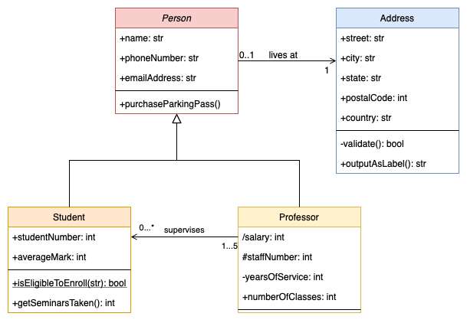
Class Diagram - Example

Slide 16
Behavioral Modelling
State Diagram is a type of behavioral model
Depicts data and behavior of a single object throughout its lifetime.
Elements of State Diagram
Set of states (including an initial start state)
Transitions between states
Entire diagram is drawn from that object's perspective

Slide 17
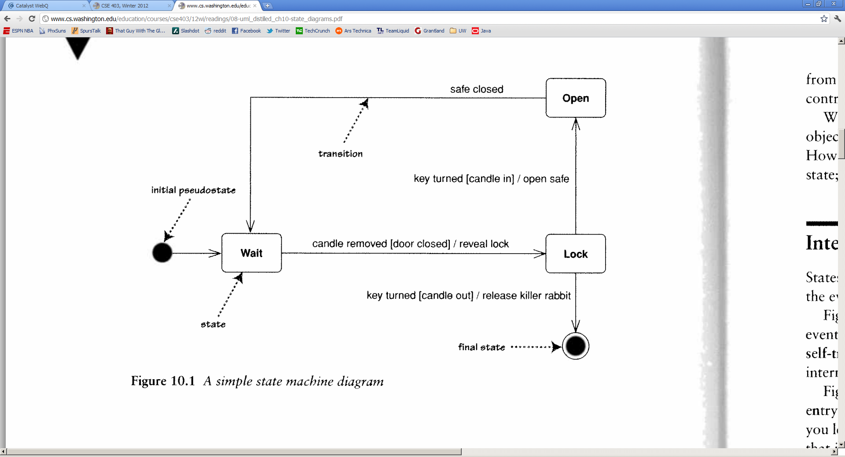
States
State: Conceptual description of the data in the object
Represented by object's field values
Entire diagram is drawn from the central object's perspective
Only include states / concepts that this object can see and influence
Don't include every possible value for the fields; only ones that are conceptually different

Slide 18
Example Scenario
I want to keep my valuables in safe that’s hard to find. So to reveal the lock to the safe, I have to remove a strategic candle from its holder, but this will reveal the lock only when the door is closed.
Once I can see the lock I can insert my key to open the safe. For extra safety, I make sure that I can open the safe only I replace the candle first. If a thief neglects this precaution, I ‘ll unleash the nasty monster to devour him.

Slide 19
State Diagram

Slide 20
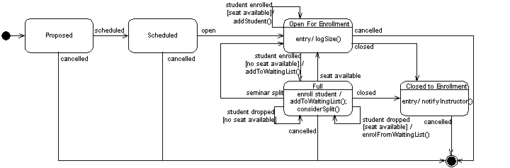
UML Statechart Diagram: Seminar during enrollment

